Slide 1
Patterns in Search: Predictors for Company Sales Growth and Other Fundamental Data
Wes Aull

Slide 2
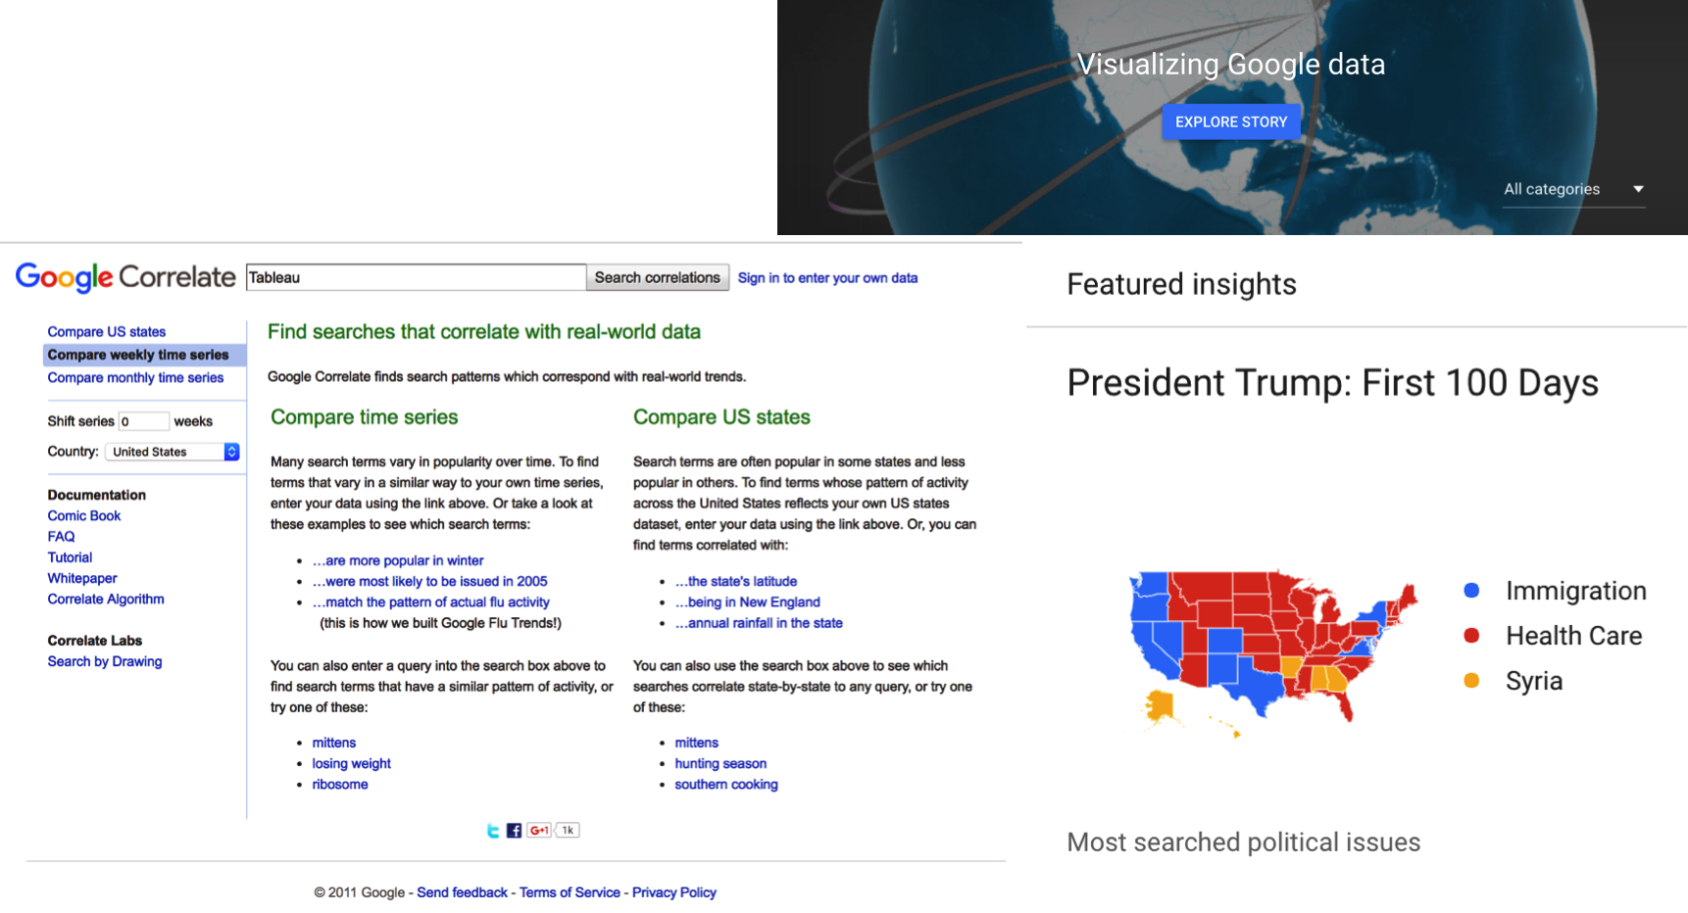
Search Insights: What Are We Looking for?
www.google.com/trends

Slide 3
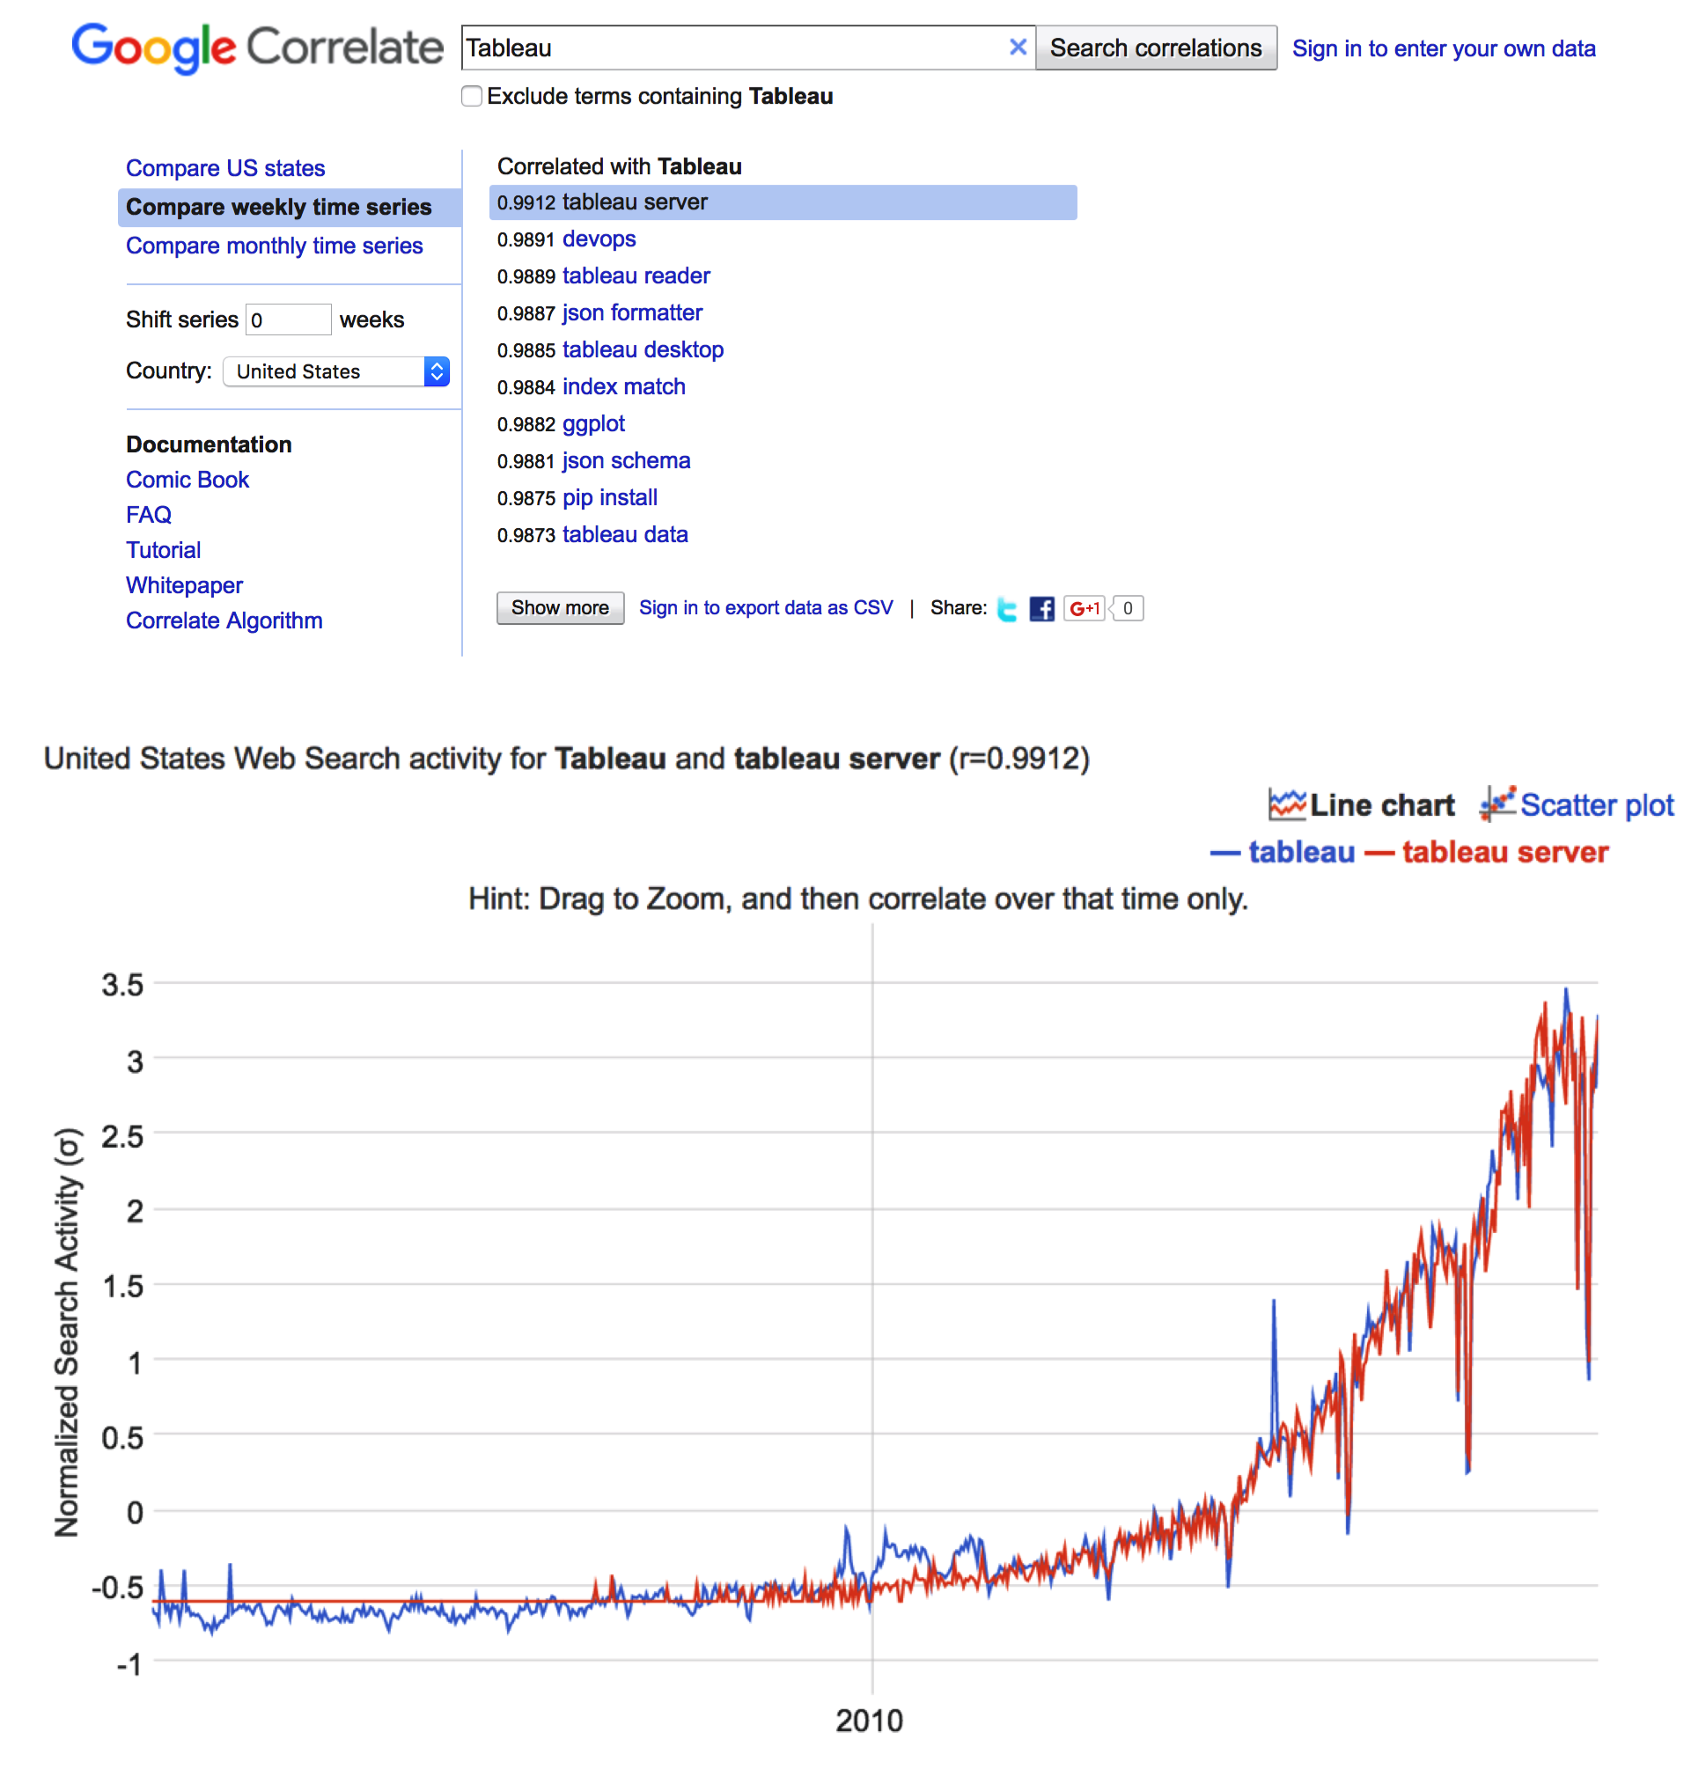
What do correlated search terms tell us about the search term itself?
What can search activity for a company tell us about its fundamental / financial health?

Slide 4

ROBOTS.txt

Slide 5
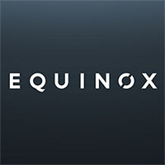





Zeyu taught me many many important lessons:
Beautiful Soup, Scrapy, Selenium
…but one stands above all:
Being a fearless nerd, stealing wi-fi and data wherever I went

Slide 6
Data Assembled
Sources
Factset via API R:
Company fundamentals & categorical data.
Google Correlate via Scrapy SQLite:
Time series of normalized search activity for a term & correlated search terms for that term.
Subset Selection
Companies chosen:
Component companies of Factset Market Indices for the following sectors -
Consumer Durables
Apparel / Footwear
Life / Health Insurance
Property / Casualty Insurance
Technology Services
Data
Factset:
Quarterly sales
Weekly share price
Weekly market capitalization
Weekly price / sales multiple
Weekly EV / EBITDA multiple
NAICS industry classification
Google Correlate:
Weekly time series of normalized search activity from 2004 – present for a company
15 highest correlated search terms to the company with Pearson correlation.
Respective search activity time series for the 15 highest correlated search terms, along with their 15 highest correlated search terms and correlations.

Slide 7
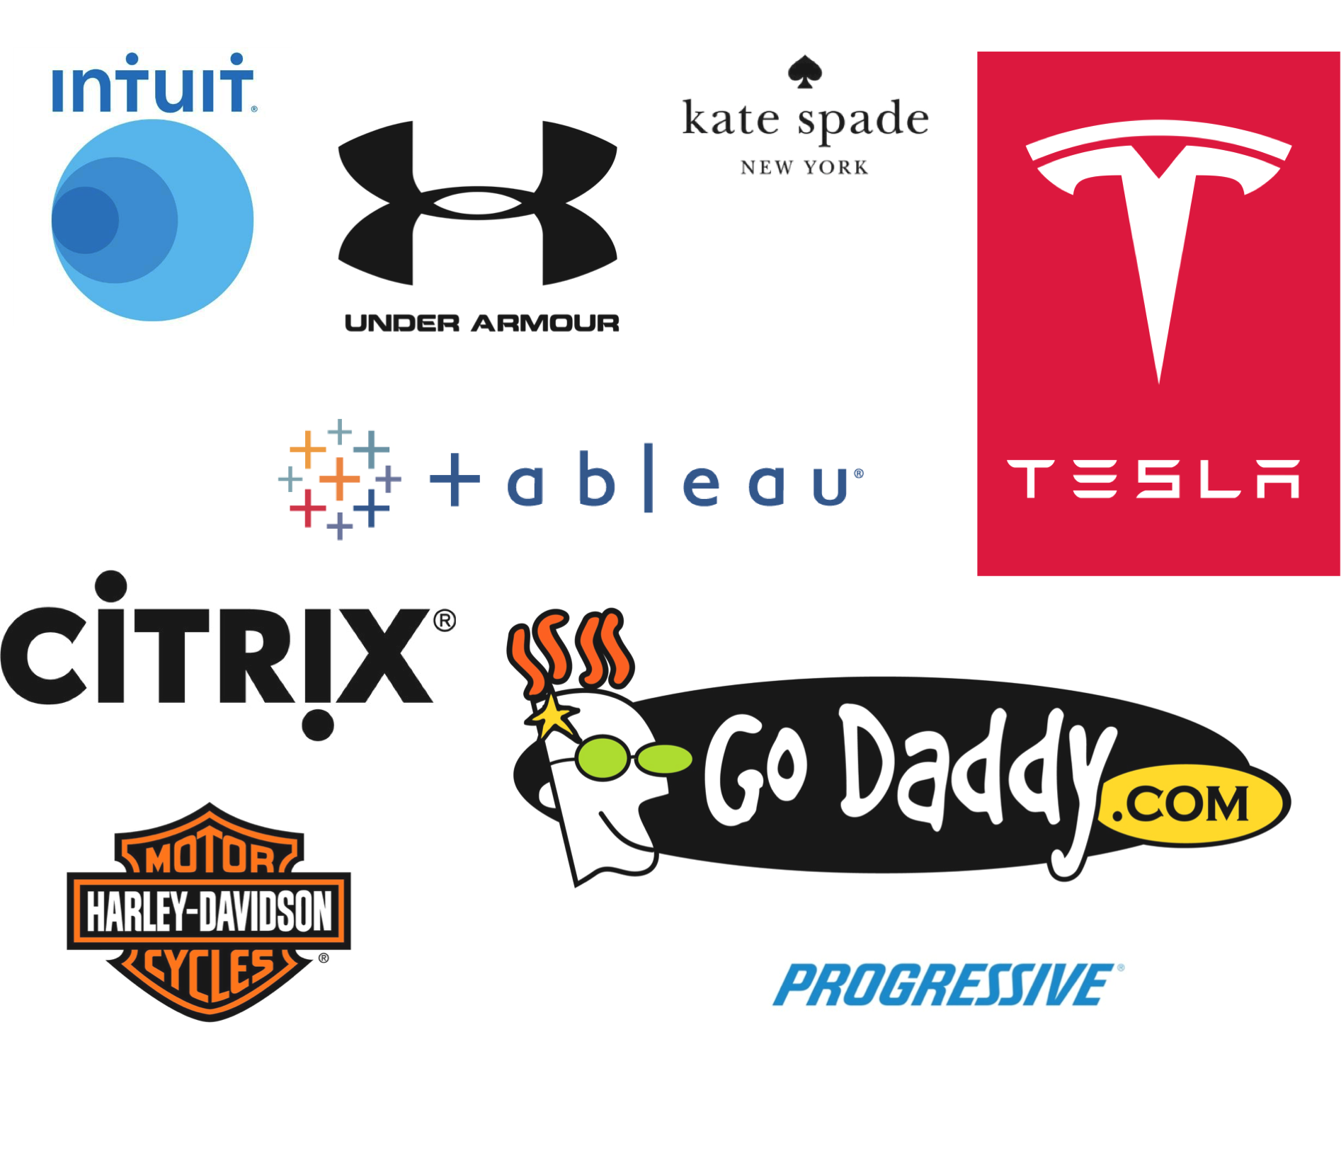

Slide 8
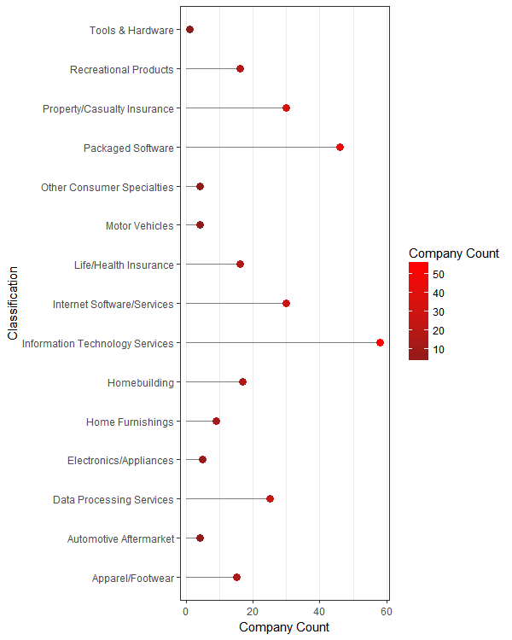
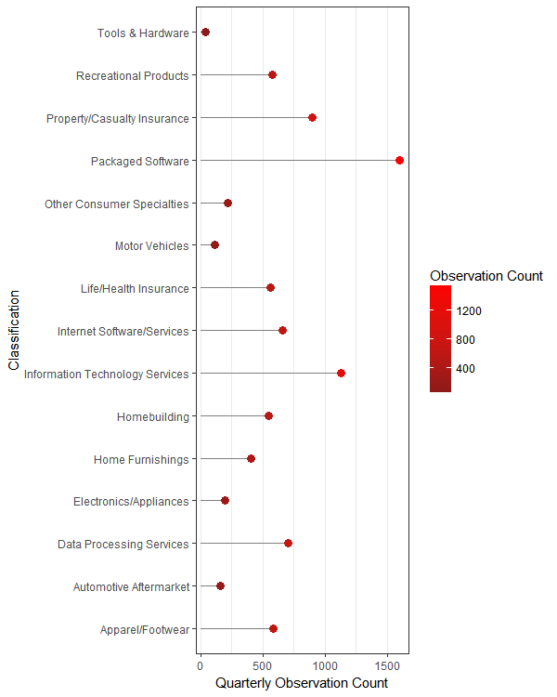
Industry Classification by Company & Observation Count

Slide 9
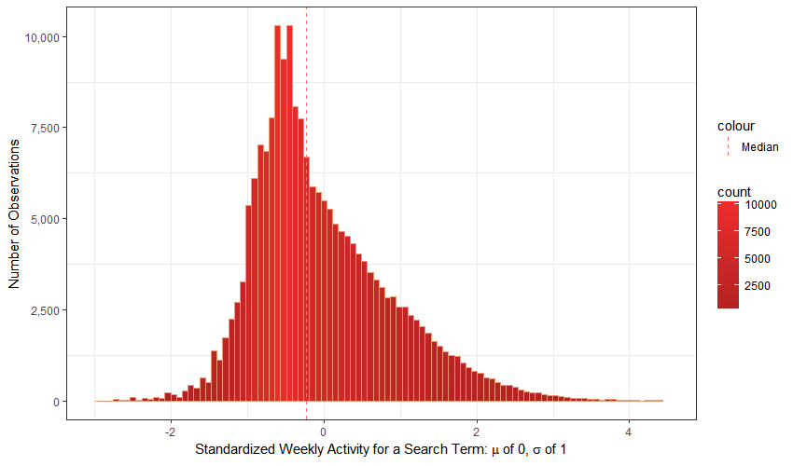
Distribution of Weekly Search Activity

Slide 10
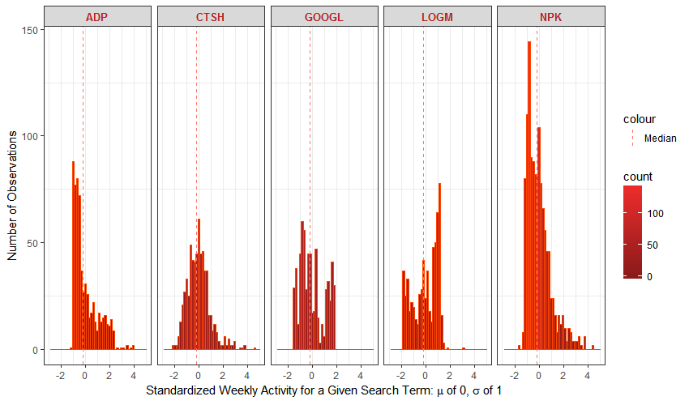
Distribution of Search Activity by Search Term

Slide 11
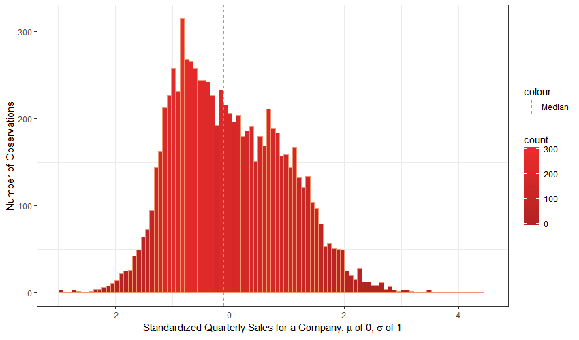
Distribution of Quarterly Sales

Slide 12
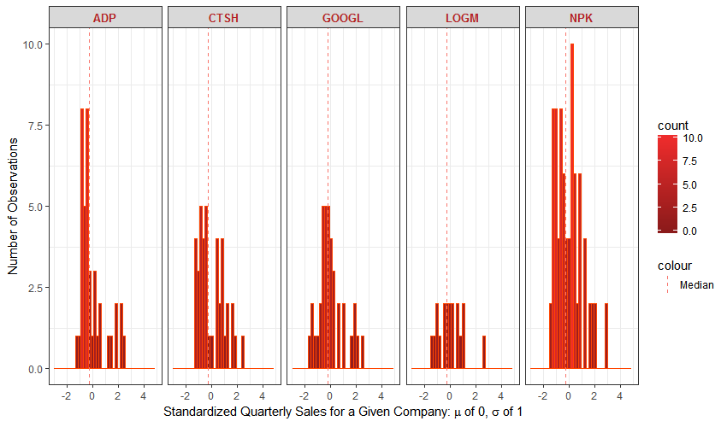
Distribution of Quarterly Sales by Search Term

Slide 13
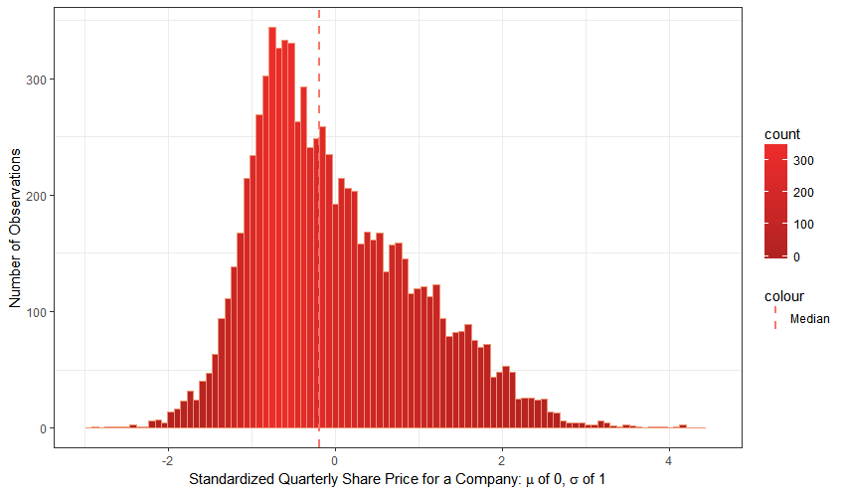
Distribution of Quarterly Share Price

Slide 14
Distribution of Share Price by Search Term

Slide 15
Modeling Sales or Share Price with Search Activity as Predictor Variable

Slide 16
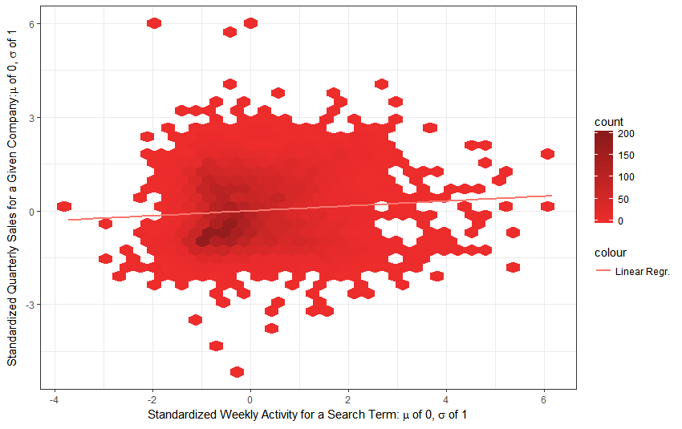
Sales v. Search Activity – Linear Regression Model
Estimated β₁ = .0784
Estimated β₀ = .0000
Adjusted R² = .0060
p-value = .0000

Slide 17
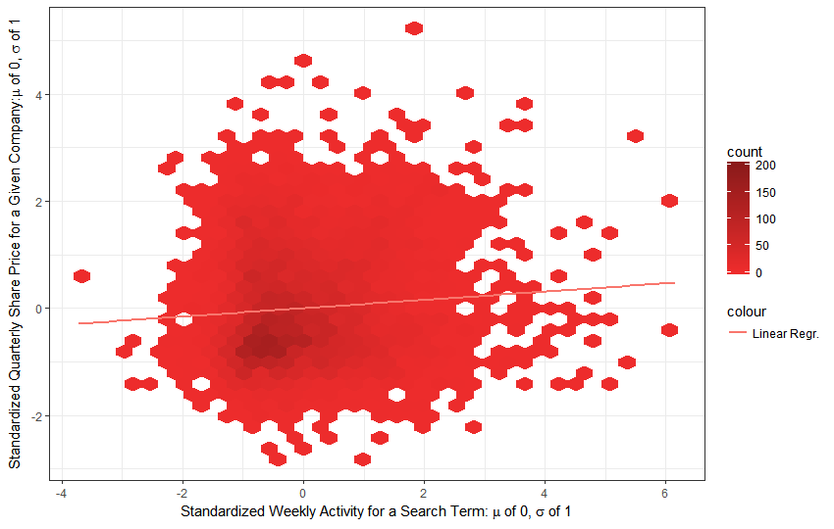
Share Price v. Search Activity – Linear Regression Model
Estimated β₁ = .0776
Estimated β₀ = .0000
Adjusted R² = .0059
p-value = .0000

Slide 18
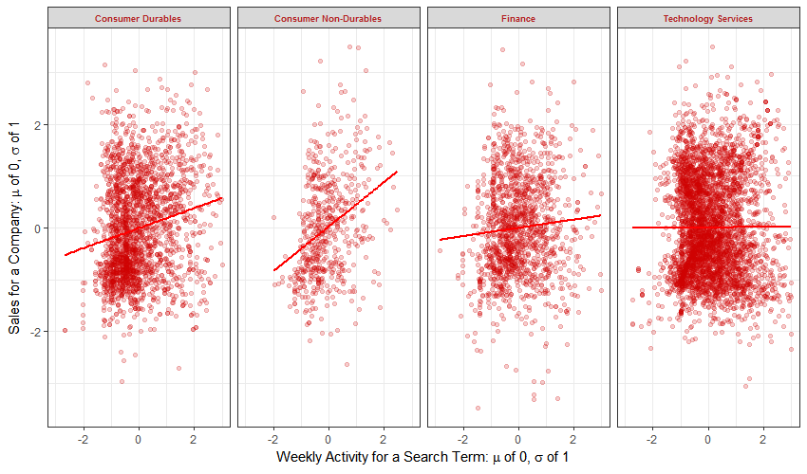
Sales v. Search Activity by Broad Sector

Slide 19
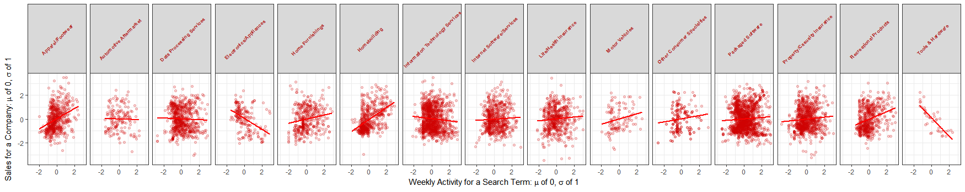
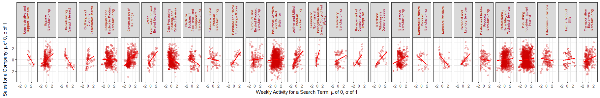
Sales v. Search Activity by Industry & Sub-Industry

Slide 20
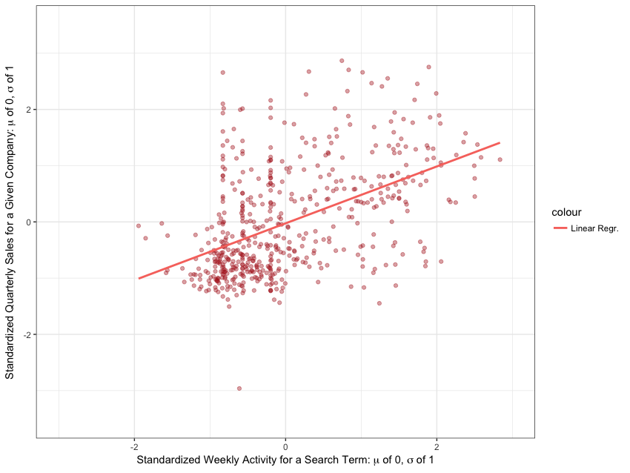
Sales v. Search Activity for Construction Industry
Estimated β₁ = .4808
Estimated β₀ = .0205
Adjusted R² = .2285
p-value = .0000

Slide 21
Take Aways & Further Work
Preliminary Conclusions:
In the aggregate, weekly search activity is complex and conditional:
Significant increase in traffic is not necessarily or often positive for a company’s fundamentals.
Significant decrease appears to predict negative developments for company fundamentals with more certainty and ability to explain variance.
At an industry or sub-industry level, an increase in traffic can have a neutral, positive, or negative influence, depending on the nature of the traffic to its business.
Aggregate traffic for technology, publishing, & software seems to have no correlation. Despite the fact that more customers may purchase their product / services via the internet, they also have a great amount of traffic that is not sales or sales-lead related.
Retail and big-ticket product sellers (cars, recreational vehicles, home building) appear to have a significant, positive correlation between sales and search activity.

Slide 22
Take Aways & Further Work
Further Work:
Visual inspection of correlated terms (and analysis of the aggregate numerical data) brought several hypotheses for potential testing with the right NLP deployed:
Company search terms with top correlations to search terms relevant to its space or product offerings (not idiosyncratic or non-business in nature) offer a time series with more reliable / correlated signal for predicting company fundamentals.
Decision-tree modeling with added features to illuminate whether search activity is directly related to sales-leading activity could better extract a model across and specific to industries themselves.

